Slide 1

NEWS POST MANAGEMENT APPLICATION
A Platform for User-Generated News with Admin Moderation
Guidance & Mentor:
Sanjeev
Kartik
by -Venkatesh Madanwale (SWE-I)
04/29/2025

Slide 2
AGENDA
Objective
Software and Hardware Requirements
Workflow Diagram
Scope of Enhancement
Use Case Diagram
Conclusion

Slide 3
OBJECTIVE
To create a web application that allows users to post news articles.
To implement an administrative workflow for reviewing and managing user-submitted content.
To provide a platform for users to post, view news, categorized and unfiltered.
To enable user interaction with news posts through likes and dislikes.

Slide 4
SOFTWARE AND HARDWARE REQUIREMENTS
Software Requirements:
Frontend: React.js
Backend: Node.js with Express.js
Database: MongoDB
Operating System: Windows, macOS or Linux
Browser: Chrome, Firefox, Safari, Edge
Development Tools: VS Code, Git, etc.
Hardware Requirements:
Processor: Intel Core i5 or equivalent
Memory: 8GB RAM
Storage: 256GB SSD
Network: Internet connection

Slide 5
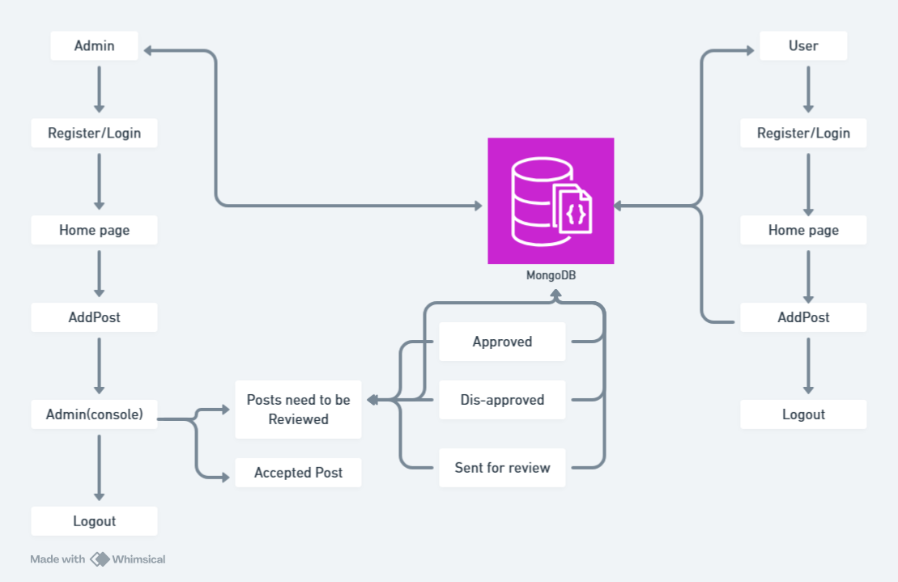
WORKFLOW DIAGRAM

Slide 6
SCOPE OF ENHANCEMENT
User profile management
Improved search and filtering
Real-time notifications
Social sharing
Comment section for news articles
Enhanced admin dashboard

Slide 7
USE CASE
User:
Registers/Login → Posts News → Views/Filters News → Likes/Dislikes
Admin:
Reviews Posts → Approves/Rejects → Posts News → Manages All Content

Slide 8
CONCLUSION
A scalable, modern news posting platform using Full-stack.
Covers both user engagement and moderation.
Potential for real-world use-cases with enhancements.

Slide 9
THANKS
FOR LISTENING
You are free to ask any question.

